Slide 1

Lightweight Web Services with Pyramid
PyCon Canada 2012
Tres Seaver
Agendaless Consulting
tseaver@agendalesscom
@tresseaver

Slide 2

The Setup
Successful startup
Web 1.0 app built w/ Pyramid

Slide 3
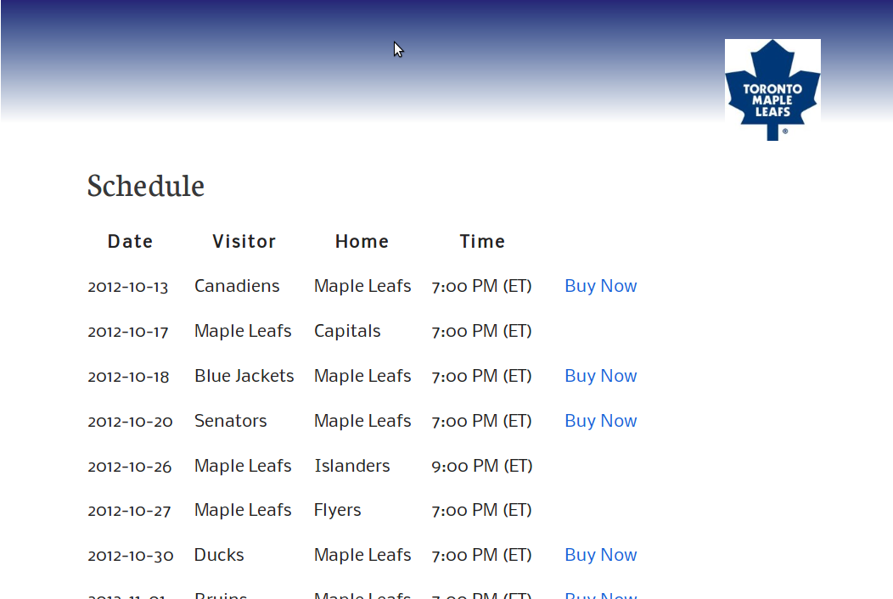
Web 1.0 Startup: Local Sports Tix

Slide 4

The Crisis

Slide 5
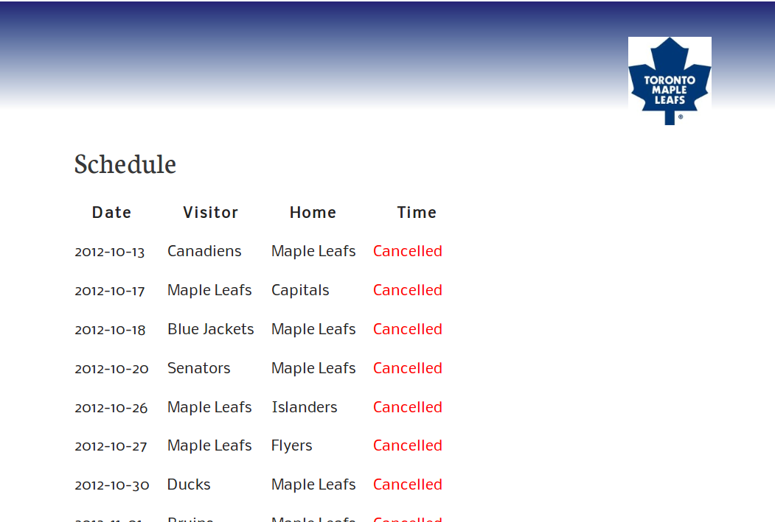
LOCKOUT!

Slide 6

The Angle
Crisis or opportunity?
Build a mobile version, FAST
More revenue opportunities
Pad your resumé ;)
é

Slide 7

The Sting
Your site is built on Pyramid
The back-end is already nearly done!
Now you get to write the mobile bit, too

Slide 8
Pyramid
Map HTTP requests to your code
“View” is a function/callable which takes a request and returns a response
def view(request):
return Response(body='<h1>Hello, World!</h1>')

Slide 9
Renderer
View can return data, used by “renderer” to generate response
def view(request):
return {'prompt': 'Hello, World!'}

Slide 10
Templates are Renderers
Chameleon ex. →
Pyramid supports Chamelon, Jinja2, and mako
<html>
<body>
<h1>${prompt}</h1>
</body>
</html>

Slide 11
Example view: Season Schedule
#views.py
SEASON = [('2012-10-13', True, 'Canadiens',
'Maple Leafs', '7:00 PM (ET)'),#...
]
def _mapping(row):
return {'date': row[0], 'avail': row[1],
'visitor': row[2], 'home': row[3], 'time': row[4]}
def schedule(request):
return {'schedule':
_mapping(game)for game in SEASON}

Slide 12
Example template
<html>
<body>
<table>
<tr><th>Date></th><th>Visitor</th>...
<tr tal:repeat=”game schedule”>
<td>${game['date']</td>
...
</tr>
</table>
</body>
</html>

Slide 13
Configuring the View
# views.py
from pyramid.view import view_config
@view_config(route_name='home',
renderer='templates/schedule.pt')
def schedule(request):
# as before

Slide 14
Configuring the Application
# main app config
from pyramid.config import Configurator
def main(global_config, **settings):
config = Configurator(settings=settings)
config.add_route('home', '/')
config.scan()
return config.make_wsgi_app()

Slide 15
Alternate renderer: JSON
Instead of a template, we can pass a callable, or the name of a registered renderer
Multiple views can be declared for a single view function

Slide 16
Configuring Another View
# views.py
from pyramid.view import view_config
@view_config(route_name='json',
renderer='json')#registered name
@view_config(route_name='home',
renderer='templates/schedule.pt')
def schedule(request):
# as before

Slide 17
Add Another Route
# main app config
from pyramid.config import Configurator
def main(global_config, **settings):
config = Configurator(settings=settings)
config.add_route('home', '/')
config.add_route('json', '/index.json')
config.scan()
return config.make_wsgi_app()

Slide 18
Profit!
$wget -o - http://example.com/index.json
{"schedule": [{"date": "2012-10-13", "available": true, "time": "7:00 PM (ET)", "home": "Maple Leafs", "visitor": "Canadiens"}, ...

Slide 19
Cornice
Mozilla framework atop Pyramid
Validated schemas for RESTish web services
Support for unified collection / item handling
Auto-generated API docs

Slide 20
Cornice Example
#views.py
from cornice.resource import resource
@resource(collection_path='/members/',
path='/members/{m_id}')
class MemberProfiles(object):
def __init__(self, request):
self.request = request
def collection_get(self):
return _members
def get(self):
m_id = self.request.matchdict['m_id']
return members[m_id]1

Slide 21
Links / Q&A
Pyramid
http://www.pylonsproject.org/
Cornice
https://github.com/mozilla-services/cornice

